Slide 1


PROJECT SIMPLE mentor :Sathish appana BANKING SYSTEM
BY :
K.NITHEESH -- 24KB1A04G7
Y.ABHISHEK KUMAR REDDY -- 24KB1A04BY
D.VINAY -- 24KB1A0478
P.SRINADH -- 24KB1A04R0
SK.FAIKUDDHIN -- 24KB1A04X4
K.NIRANJAN -- 24KB1A04G5

Slide 2

Introduction :
A basic banking system implemented in C,
featuring operations like account creation,
deposit, withdrawal, and balance inquiry.
It uses fundamental data structures such as
structures, arrays, and linked lists to
manage customer data efficiently,
demonstrating core programming and
data handling concepts

Slide 3

Disadvantages of previous banking system:
1. Manual Record-Keeping ➡️ Time-consuming and prone to human error
2. Lack of Security ➡️ No encryption or authentication methods.
3. No Real-Time Access ➡️ Users cannot access account information instantly.
4. Difficult to Search or Sort Data ➡️ Linear search is slow; no indexing.

Slide 4

advantages of present banking system :
1.Fast & Efficient Processing ➡️ C language executes operations quickly with low memory usage.
2. Structured Data Management ➡️ struct helps group account details logically (name, balance,
number, etc.)
3. Quick Search & Retrieval ➡️ Trees and hash tables allow fast access to customer records.
4. Dynamic Account Handling ➡️ Linked lists let us add or delete accounts without fixed size limitations

Slide 5

Objectives :
1. Simplify Banking Operations ➡️ Automate basic functions like deposit, withdrawal, and balance checking.
2. Store and Manage Customer Data Efficiently ➡️ Use struct and arrays or linked lists to hold customer records securely.
3. Ensure Fast Access to Account Information ➡️ Implement efficient search using trees or hash tables.
4. Handle Multiple Accounts Dynamically ➡️ Use data structures like linked lists to allow scalability and flexibility.

Slide 6

Working of the project :
Initialization
A Bank structure holds an array of Account structures and a
counter for total accounts.
Menu-Driven Interface
Create Account
Collects account number and holder name; initializes balance to 0.
Deposit / Withdraw
Locates account by number and updates balance accordingly.
Delete Account
Removes the specified account by shifting subsequent records left.
Search Account
Displays account details if the account number exists.
Display Accounts
Lists all stored account records with details.

Slide 7
Work flow :
🔹 1. Start Program ➤ Initialize bank structure with zero accounts
🔹 2. Based on User Choice: ✅ Create Account: Add a new account with name, number, and zero balance. ✅ Deposit: Find account by number and add amount to balance. ✅ Withdraw: Check for sufficient balance, then subtract. ✅ Delete Account: Locate and remove the account, shift array. ✅ Display Accounts: Print all stored account details. ✅ Search Account: Locate and display specific account info.
🔹 3. Repeat Menu Until User Chooses Exit 🔚 4. End Program
.

Slide 8
Modules :
Main: Displays menu, calls functions.
Create Account: Adds account with name, number, balance.
Deposit: Adds amount to account balance.
Withdraw: Deducts amount if balance is sufficient.
Delete Account: Removes account and shifts others.
Display Accounts: Lists all account details.
Search Account: Finds and shows account by number.

Slide 9
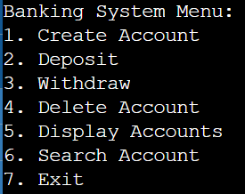
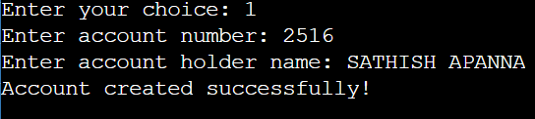
Output images :

Slide 10
Conclusion :
Efficient Banking System using C with core operations (create,
deposit, withdraw, delete, display, search).
Uses arrays and structs to manage accounts.
Future improvements: account types, interest calculation, and security.

Slide 11
thankyou for your valuable time

